Slide 1
Team Abstract
Kyle James, Will Hongach, Dean Jones, Kevin Billotti

Slide 2
Design - General
⚔️ - Dungeon crawler [real-time]
🥞 - Top down gameplay
💯- Score-based
∞ - Infinite levels, progressively harder, bosses
🎮 - W A S D || 1 2 3 || Spacebar

Slide 3
Design - Cont’d
🚣 - Active gameplay, fast-paced
🗡️ - Simple combat
🔁 - Replayability
🔀 - Random Levels, enemies, weapons

Slide 4
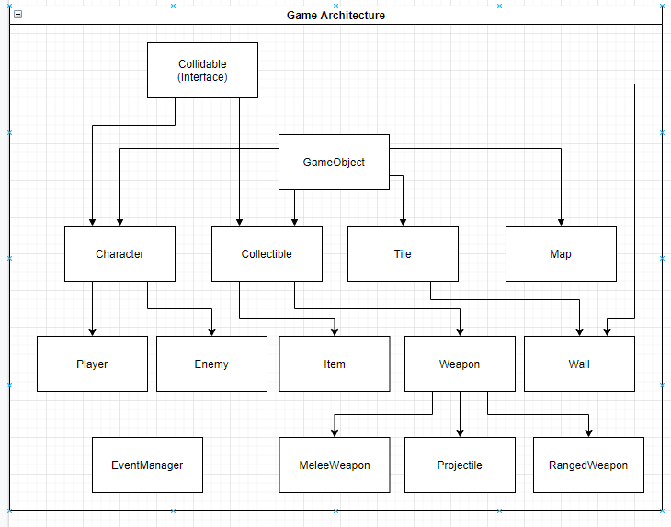
Architecture

Slide 5
Architecture - Cont’d
External Tool -
🗺️ - Main focus is on map creator
👾 - also used to create enemies
🗡️ - and weapons to avoid hardcoding

Slide 6
Art and Interface
👾 - Pixel Art
🕹️ - Fundamental Gameplay Elements
🗃️ - Simple and Organized
↗️ - Linear Progression

Slide 7
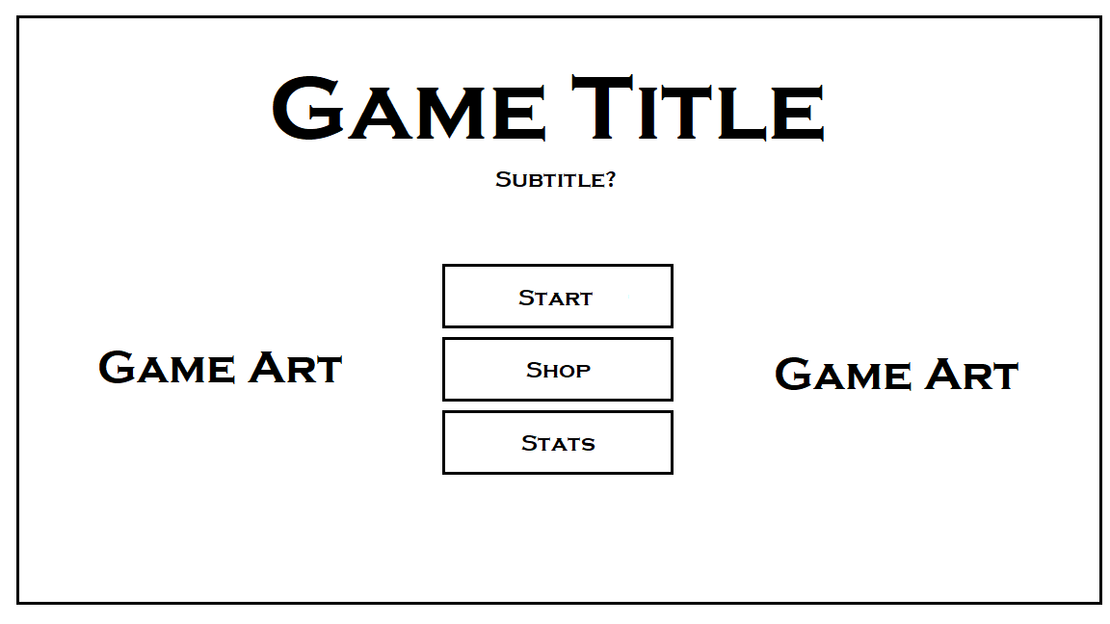
Main Menu

Slide 8
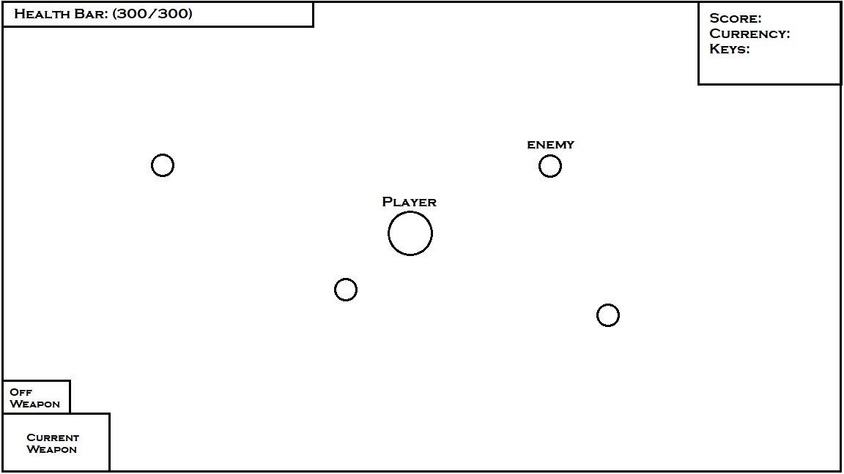
Gameplay Interface

Slide 9
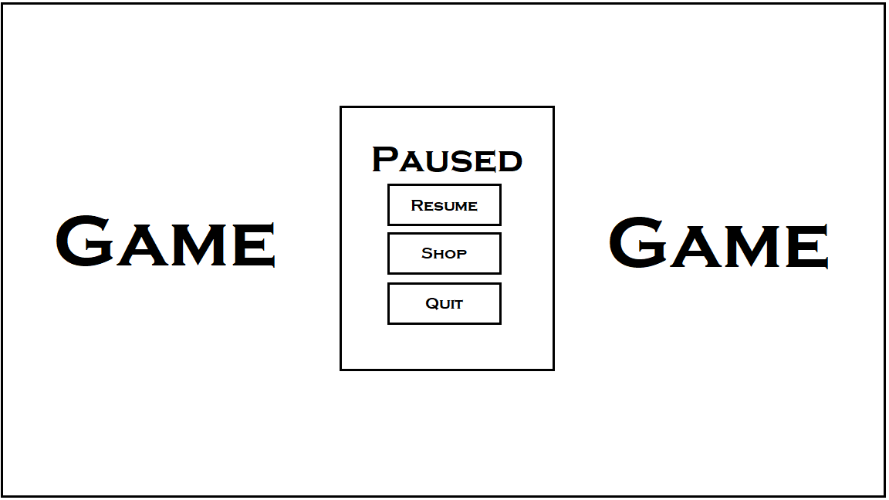
Pause Menu

Slide 10
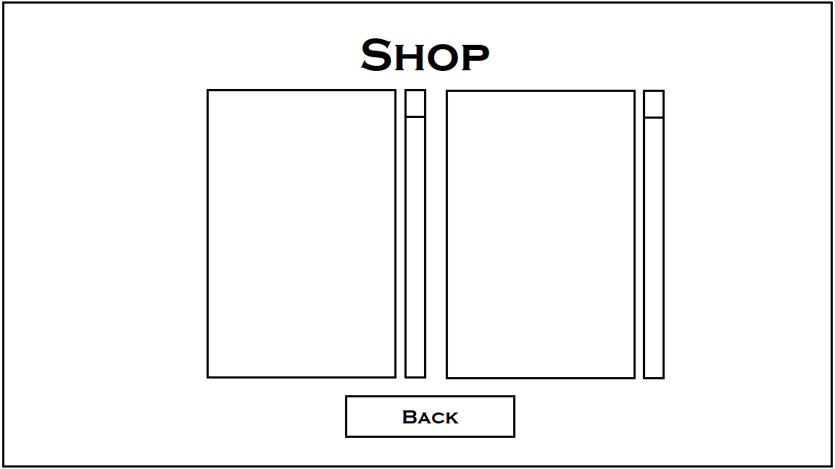
Shop/Upgrades Menu

Slide 11
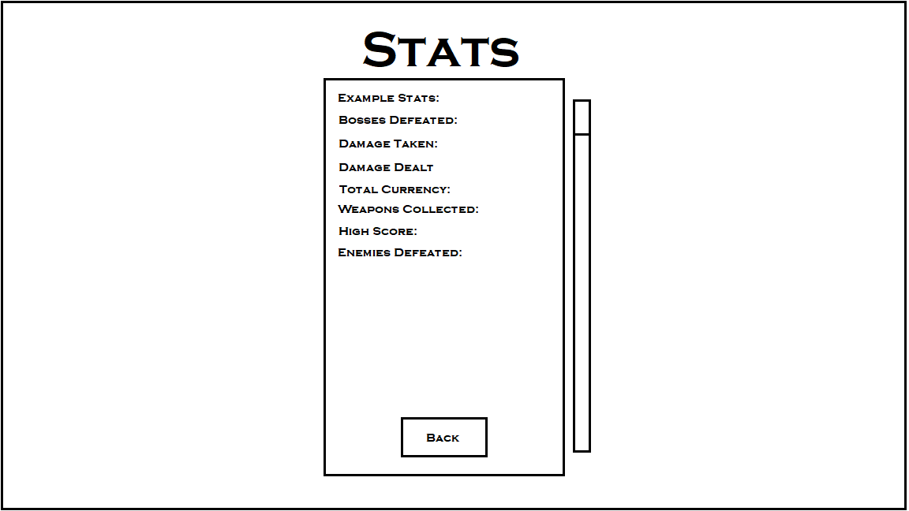
Stats Menu

Slide 12
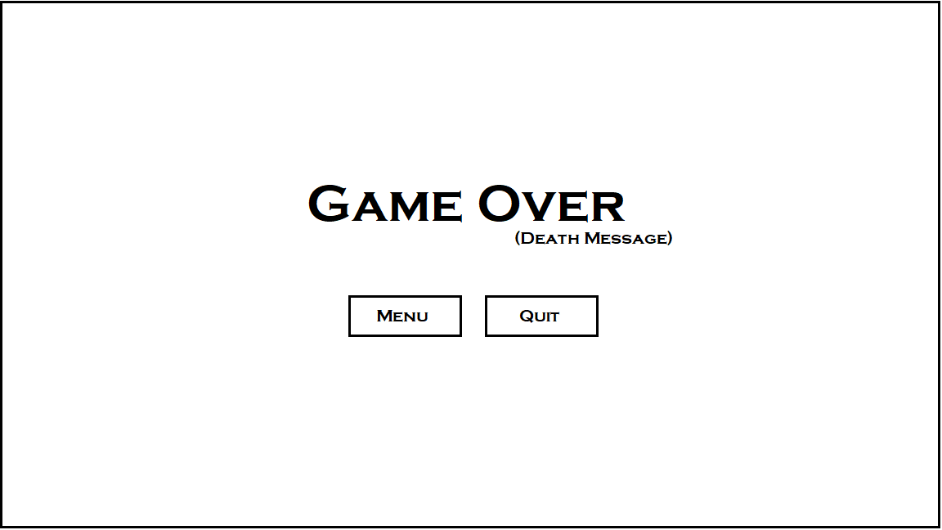
Game Over Display

Slide 13
Production - General
📅 - Weekly Meetings, Wednesdays, 1 pm
🛠️ - External Tools [💬 Discord] [⌛ Trello]
🎮 - Necessary vs Time
❗ - Player, Enemies, Collectibles, Levels, States
❓ - Bosses, Classes, Shop, Map Generation

Slide 14
Production - Timeline
📅 - Seven Tentative Weeks [Three Concrete]
🧱 - First Three Weeks [Milestone Two]
👾 - Next Two Weeks [Milestone Three]
🕹️ - Final Three Weeks [Milestone Four]
🌊 - Subject to Change. Full Schedule.

